Slide 1








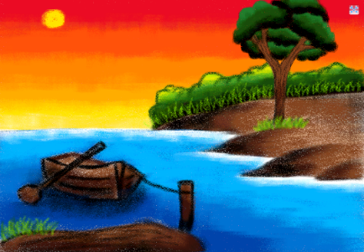



INDIAN SCHOOL AL WADI AL KABIR
AFTERNOON SHIFT
COMPUTER
FESTIVAL
2016
CYBER CHAMP HUNT 2016
EXPLORING YOUR I.T. TALENTS
CLASS | TOPIC | SOFTWARE | DATE
II | I LOVE NATURE | MS-PAINT | 16.11.16
CRITERIA OF JUDGING
TOOLS AND TECHNIQUES USED CREATIVITY PRESENTATION

